Slide 1
Dialogue Sunday School:
Introducing New Testament 2023

Slide 2
“No biblical interpretation is ever developed in a social or cultural vacuum. Most interpretations are autobiographical, where we ascertain the meaning of the text through the telling of our own stories, projecting onto the Bible how we define and interpret the biblical story in light of our own life experiences. . . . All “official” interpretations reflect the social location of those with authority to make their personal interpretations the acceptable societal norm.” –Miguel de la Torre, Reading the Bible from the Margins, p. 3.
(Social location: A combination of factors, including your race, gender, sex, age, socioeconomic class, geographic location, ability, religion, etc. that affect your identity)

Slide 3
2) Matthew 16:18: “Upon this rock will I build my church”
Far too often, interpretations of the New Testament have been used as rocks to throw at people rather than as rocks on which to build a good society and point people to God.

Slide 4
The New Testament has been weaponized to hurt (among others):
Jews
BIPOC
Women
LGBTQ folk
Two inadequate approaches in Mormonism:
Skipping over the parts we feel uncomfortable with
Coming up with answers too quickly
How can we read the New Testament more abundantly and also truthfully?

Slide 5
The New Testament and the Jewish Faith
How has the New Testament been interpreted to cause harm?
Common misconceptions
Jesus invented feminism
Jews thought that if you were rich you righteous and Jesus reversed that
Jews were engaged in works righteousness and legalism
Temple was an awful system that exploited peasants and enforced terrible purity laws
John 8:44

Slide 6
The New Testament and Jewish Faith
Jesus is part of a long line of prophets, parable tellers, and miracle workers
Elijah raised the dead and healed people, Nathan told parables, infant Moses survived a genocide
“It’s the same music, played on different instruments and in a different key.”
Women in the New Testament
Mary and Martha
Parable of the woman with the lost coin
Bent over woman Jesus heals
Women in the temple
Jesus cares about the Torah
Rather than thinking “Jesus overturned the law,” we can think “Jesus expanded the law” or “built a fence around the law.”
Jesus at the temple
Caring for the poor/works righteousness– read Deuteronomy

Slide 7
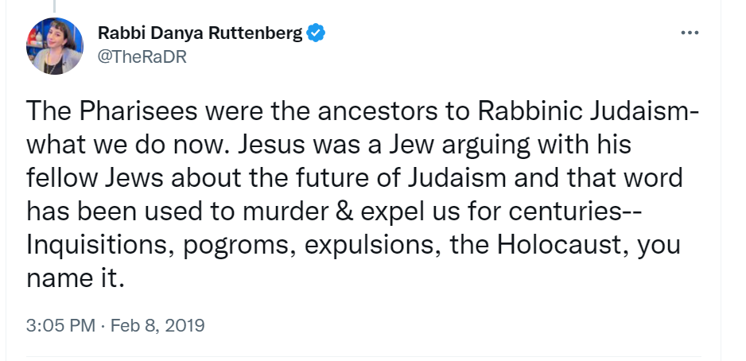

Slide 8
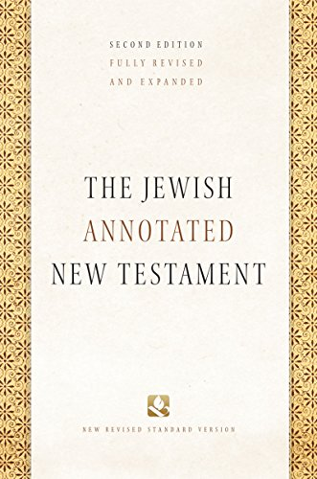
Jewish Annotated New Testament
Ed. Amy-Jill Levine and Marc Zvi Brettler

Slide 9
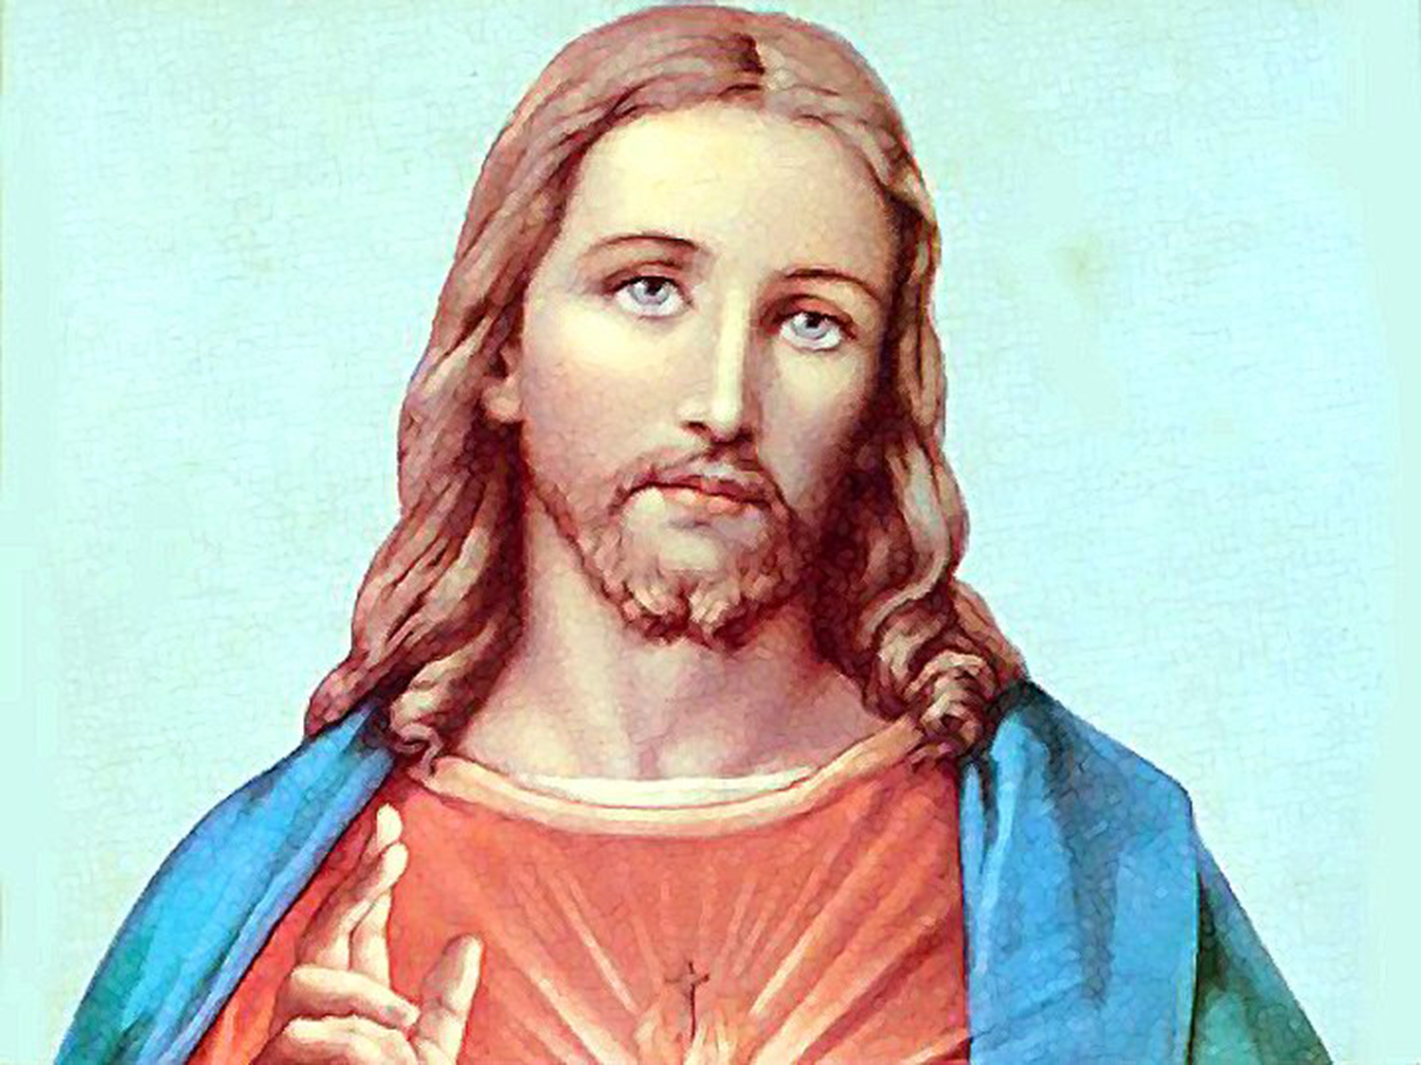
The New Testament and BIPOC
How has the New Testament been interpreted to cause harm?
Ephesians 6:5-8: Slaves, be obedient to them that are your masters according to the flesh, with fear and trembling, in singleness of your heart, as unto Christ; Not with eyeservice, as menpleasers; but as the servants of Christ, doing the will of God from the heart; With good will doing service; as to the Lord, and not to men: Knowing that whatsoever good thing any man doeth, the same shall he receive of the Lord, whether he be bond or free.

Slide 10
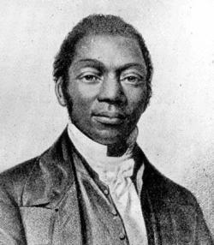
“Does the Bible condemn slavery without any regard to circumstances, or not? I, for one, desire to know. My repentance, my faith, my hope, my love, my perseverance all, all, I conceal it not, I repeat it, all turn upon this point. If I am deceived here–if the word of God does sanction slavery, I want another book, another repentance, another faith, and another hope.”
- Reverend J.W.C. Pennington, 1845

Slide 11
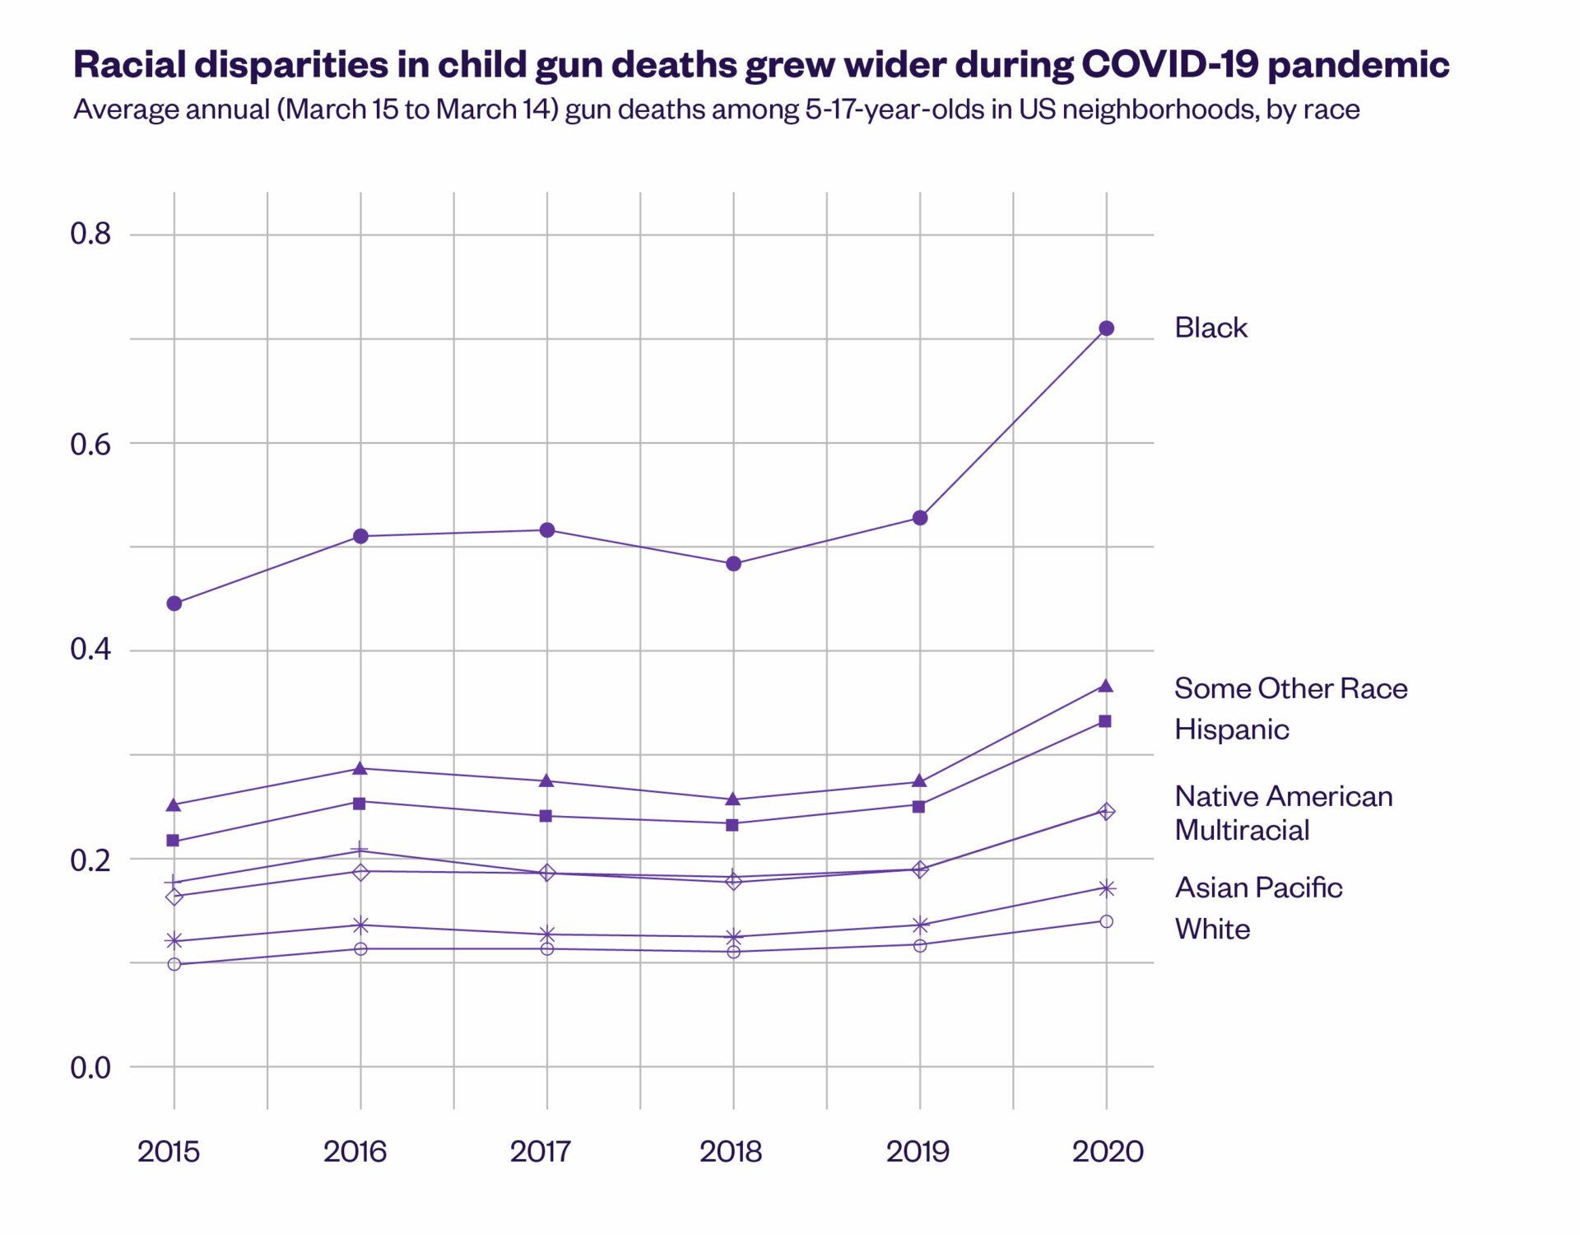

Slide 12
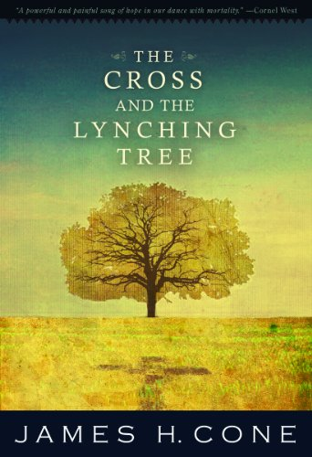
The Cross and the Lynching Tree
James H. Cone

Slide 13
“In their spiritual wrestling, black Christians experienced the weakness and power of God’s love revealed in the cross–mysteriously saving them from loneliness and abandonment and ‘the unspeakable violence . . . by bloodthirsty mobs.’ Black ministers preached about Jesus’ death more than any other theme because they saw in Jesus’ suffering and persecution a parallel to their own encounter with slavery, segregation, and the lynching tree.” -James Cone, The Cross and the Lynching Tree, p. 75.

Slide 14
The New Testament and BIPOC
The primary question: How to reconcile the gospel message of liberation with the reality of oppression?
Reverend Dr. Martin Luther King, Jr.:
God’s love created all humans for each other in community (thesis)
White supremacy is the sin that separates people in much of the world (antithesis)
God reconciled humanity through the cross, preventing white supremacy from having “the final and ultimate word on human relationships (synthesis)
Dr. Cone: “God’s reconciling love in the cross empowered human beings to love one another–bearing witness with ‘our whole being in the struggle against evil, whatever the cost.’ Thus, blacks and whites together were free to create . . . the Beloved Community in our religious life.” (p. 71)

Slide 15
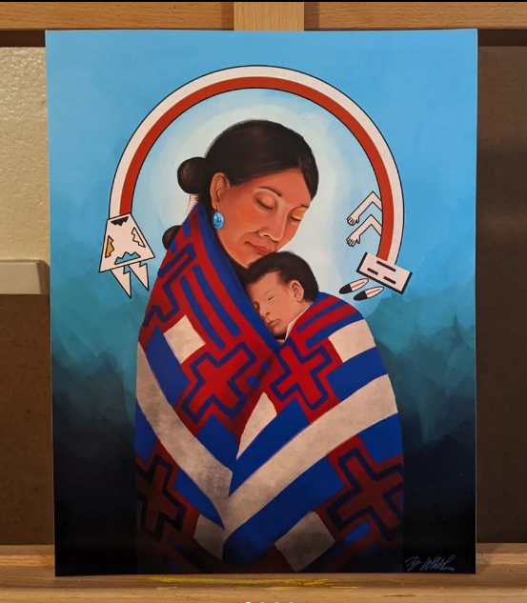
The New Testament and BIPOC
“Lynchsong” by Lorraine Hansberry
Laurel:
Name sweet like the breath of peace
Blood and blood
Hatred there
White robes and
Black robes
And a burning
Burning cross
cross in Laurel
cross in Jackson
cross in Chicago
And a
Cross in front of the City Hall
In:
New York City
Navajo Madonna and Child
by Tyrone Whitehorse. @whitehorsearts

Slide 16
LDS Artists Creating Diverse Depictions of Jesus & NT
Esther Candari
Jorge Cocco
Rose Datoc Dall
Melissa Tshikamba
Sarah Richards Samuelson
Michelle Franzoni Thorley
Emma Taylor
José de Faria
Regan Reichert
Jenna Conlin
J. Kirk Richards
Anthony Sweat
Arawn Billings

Slide 17
The New Testament and Women
How has the New Testament been interpreted to cause harm?
Ephesians 5:22-23: Wives, submit yourselves unto your own husbands, as unto the Lord. For the husband is the head of the wife, even as Christ is the head of the church: and he is the savior of the body.
Mark 8:34: For whosoever will save his life shall lose it; but whosoever shall lose his life for my sake and the gospel’s the same shall save it.

Slide 18
The New Testament and Women
Hermeneutics of experience: particularly the experiences of women (contemporary and Biblical)
Hermeneutics of domination and social location: how social, cultural, and religious location shapes our experience with the text
Hermeneutics of suspicion: approach the text with caution; it could be dangerous
Hermeneutics of critical evaluation: weigh the oppressive tendencies and liberating possibilities. Ask: What does the text do to those of use who submit to its world of vision and values?
Hermeneutics of creative imagination: dream of a world of justice and well-being for all people. Use art, story-telling, and imagination to work with the text to reach for that world.
Hermeneutics of remembering and reconstruction: retrieve traditions of women that have been passed over. Whose histories have been lost? Whose voices have been silenced?
Hermeneutics of transformative action for change: create a vision for a new humanity in which the text is used to build beloved community or Zion.
-Elizabeth Shüssler Fiorenza, Wisdom Ways: Introducing Feminist Biblical Interpretation

Slide 19
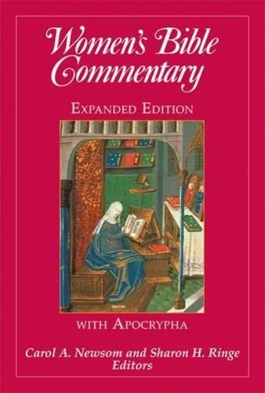
Women’s Bible Commentary
Ed. Carol A. Newsom and Sharon H. Ringe

Slide 20
The New Testament and LGBTQ Folk
How has the New Testament been interpreted to cause harm?
Romans 1:18-32; 1 Corinthians 6:9; 1 Timothy 1:10: all taken out of the sexual context of the time to condemn homosexuality and queerness.

Slide 21
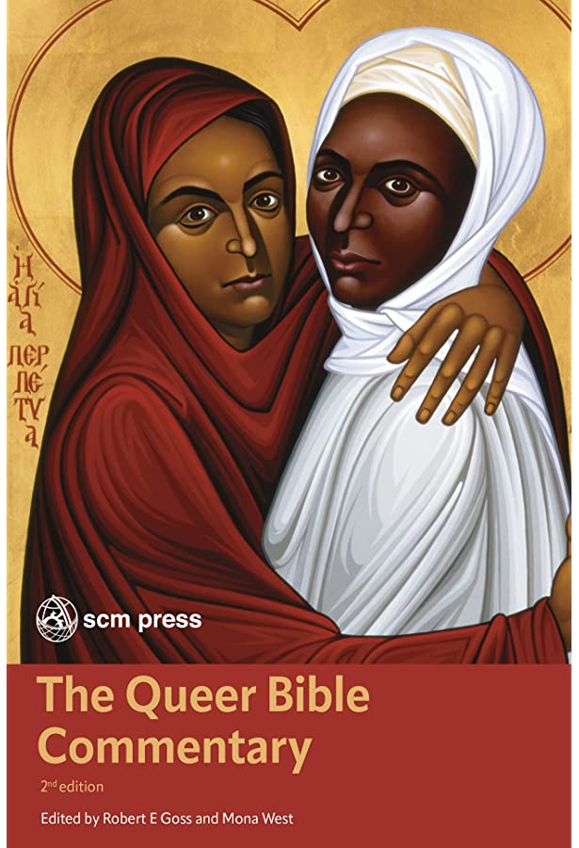
The Queer Bible Commentary
Ed. Robert E. Goss and Mona West

Slide 22
The New Testament and LGBTQ Folk
Matthew 19:3-9
Jesus is putting two scriptures together here: Deuteronomy 24: 1-4 and Genesis 2:24. The two texts are in conflict, because Genesis says one thing about divorce and Deuteronomy says another. When Jesus says “in the beginning it was not so,” he’s saying, the older text wins out.
Could we do the same for Genesis and Leviticus/Romans/Corinthians?
Genesis 2:18– “it is not good for man to be alone”

Slide 23
Create Touchstones and Choose How to Read
Luke 4:18-19– Jesus’ 1st recorded sermon “The Spirit has sent me to heal the brokenhearted”
1 Corinthians 13– Paul’s hymn to love
Sermon on the Mount
1 John 4:14–the woman at the well
1 Peter 4:8–charity
2 Timothy 1:7–God has given us power
Romans 8:38-39–nothing can separate us from God’s love
Romans 12:2–be transformed by God
Philippians 4:13–I can do all things through God
John 10:10–I came that they may have life, and have it more abundantly
We choose how to read.

